Slide 1
AIRPORT LAW 101
Staying Out of Trouble: Everything You Need to Know About Airport Law in 60 minutes
Peter J. Kirsch
June 4, 2023

Slide 2
Why are you listening to a lawyer at 8am on a Sunday?
I have insomnia
The thin air in Denver is getting to me
My Frontier flight, due in on Saturday afternoon, just arrived
The other alternative was listening to a TSA briefing on the latest SD
I need a catalog of all the illegal things I have done at my airport
I am a lawyer and don’t know any better
I was wondering the same thing myself

Slide 3
TODAY’S PRESENTATION
  Basics of airport law
  Focus on federal law and regulations
  Understand why airport law means airports are not like other local government functions

Slide 4

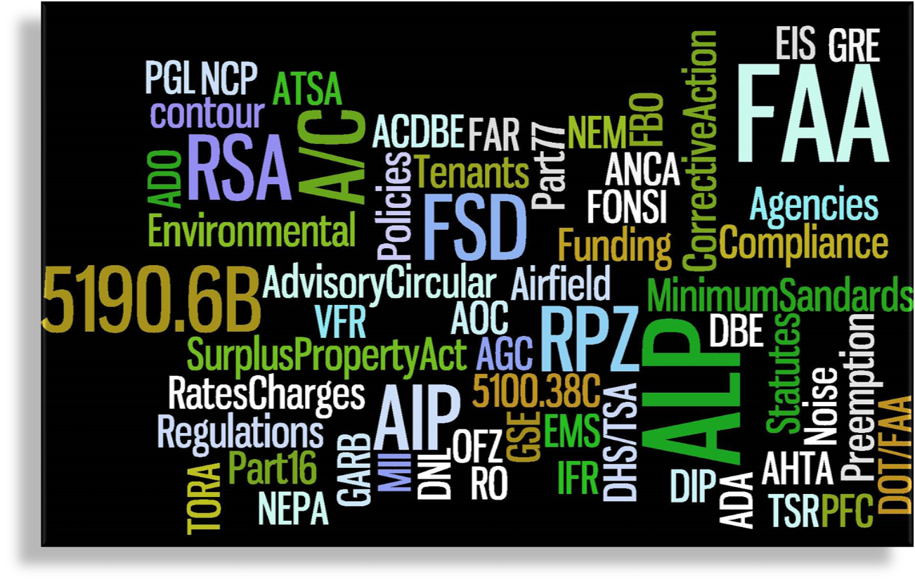
AIRPORT LAW AND AIRPORT TERMINOLOGY CAN BE CONFUSING

Slide 5
WHY SHOULD I CARE ABOUT AIRPORT LAW?
  Know when to call your lawyer
  Identify basic problems before they arise
  Understand why airport decisions are made
  Better able to provide advice and counsel to airport officials

Slide 6


AIRPORT LAWYERS NEED MANY TENTACLES
Land Use
Real
Estate
Safety
Public Health
Regulatory
Compliance
Bonds
Contracts

Slide 7

DIVIDED LEGAL RESPONSIBILITY
The Early Model
Today's Focus
Federal Government
Private
Sector
Airspace
Air Service
Airports
Local
Government

Slide 8

REALITY MUCH FUZZIER LINES
Local Gov't
Feds
Private

Slide 9
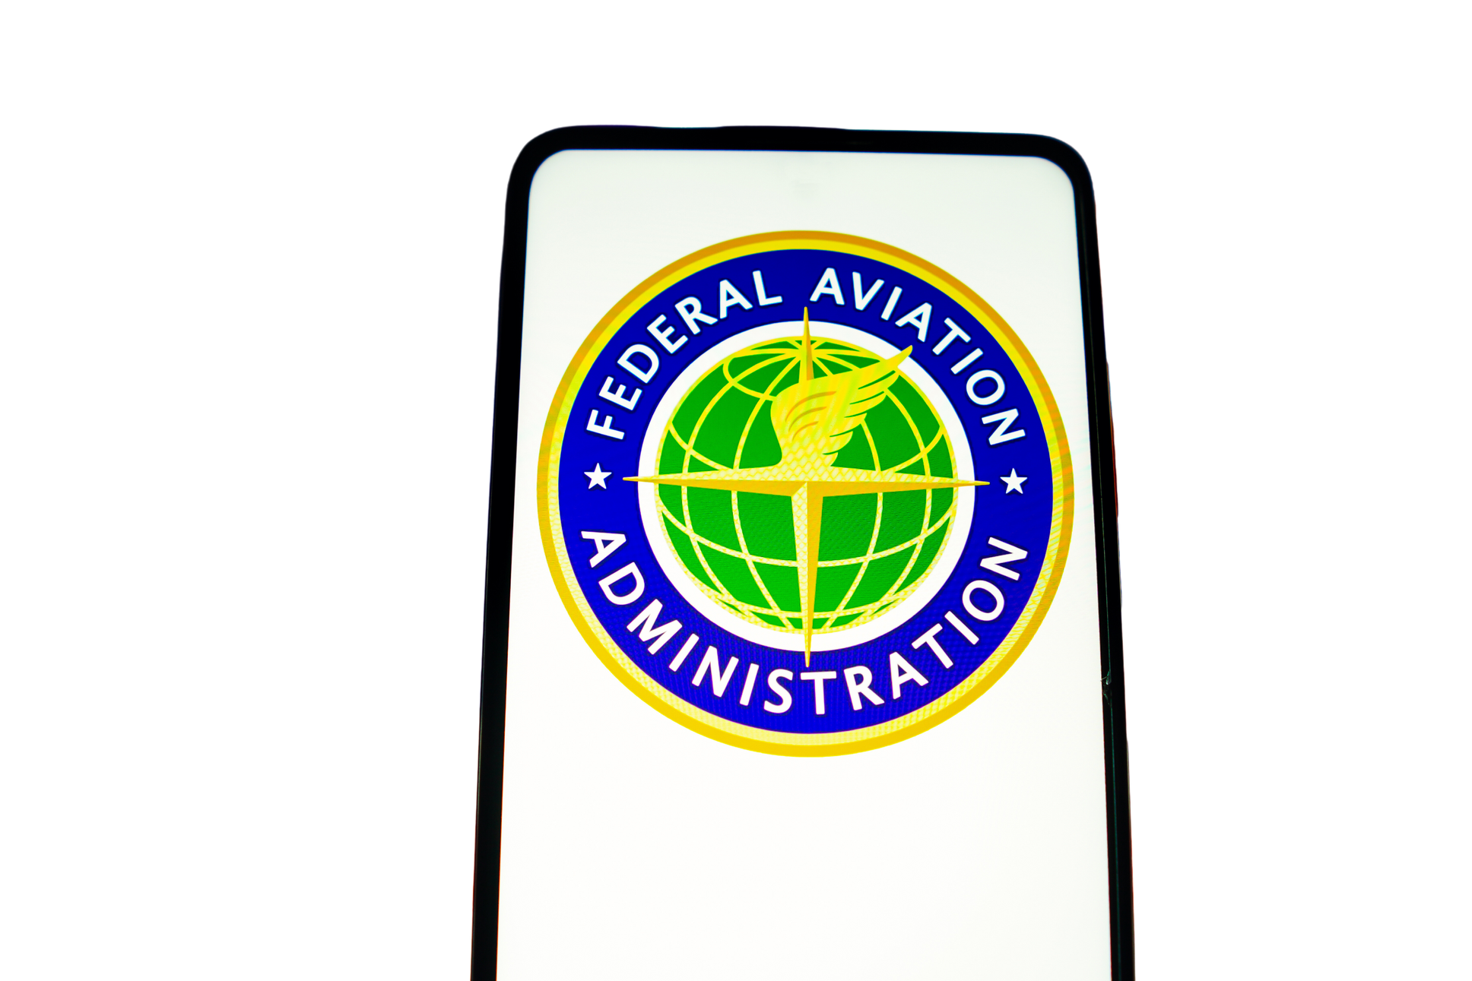


FEDERAL LAW AND REGULATION IS PERVASIVE

Slide 10

FAA’S RELATIONSHIP WITH AIRPORT SPONSORS
Funder
Regulator
Adjudicator
Advocate

Slide 11
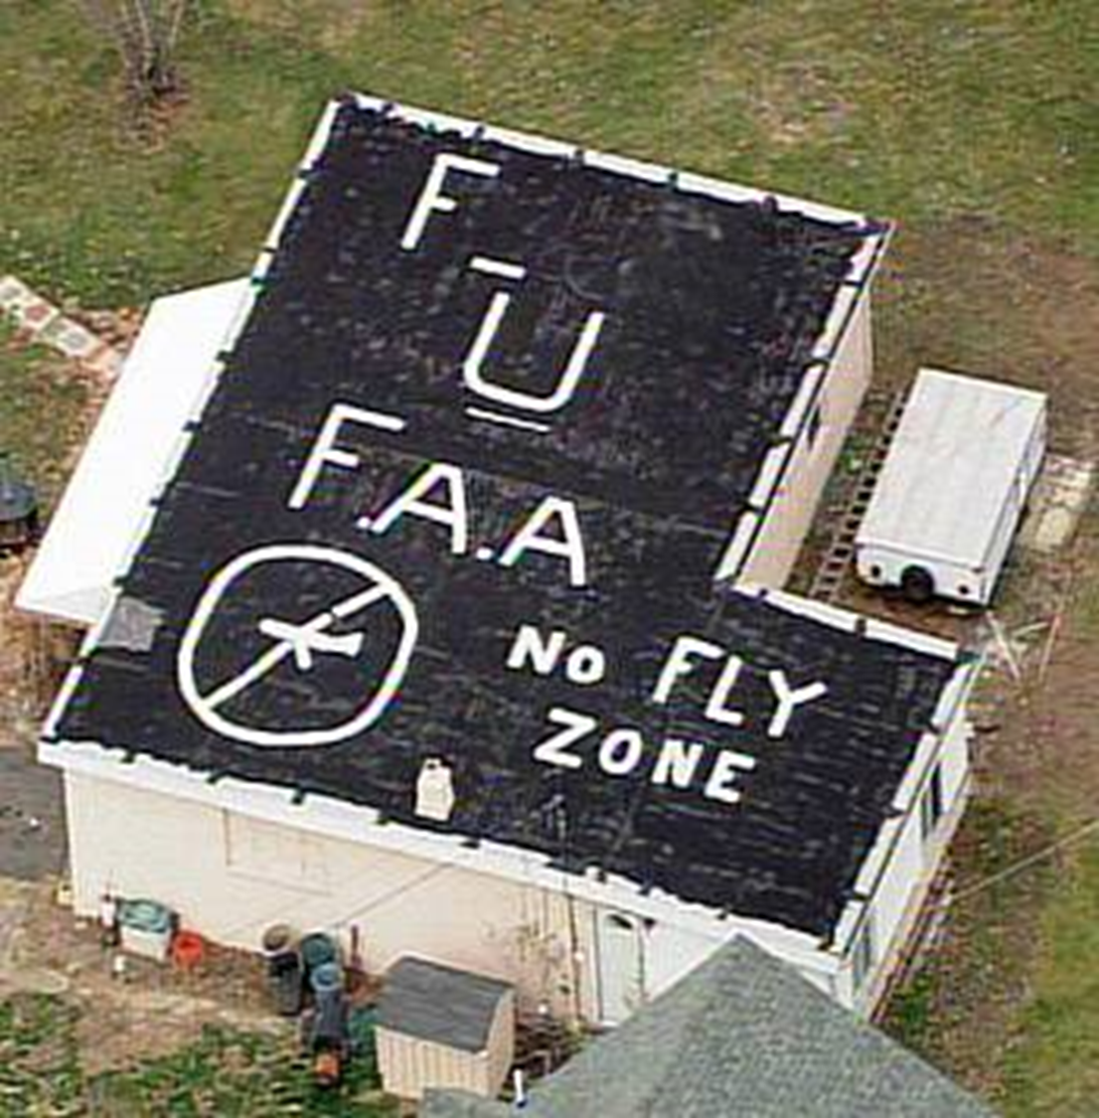
OTHER RELATIONSHIPS WITH FAA

Slide 12

AIRPORT LAW TAKES MANY FORMS
Formal federal sources
  Statutes (Title 49 of the U.S. Code)
  Federal Aviation Regulations (Title 14 of the Code of Federal Regulations)
  Administrative Adjudications (14 C.F.R. Part 16)
Local Sources
  Minimum Standards
  Rules and Regulations
  Healthy and Safety rules

Slide 13
INFORMAL – EQUALLY IMPORTANT- SOURCES
Guidance and Policy
FAA Orders
FAA Advisory Circulars
FAA Policy Statements
FAA Guidance Letters
FAA Standard Operating Procedures (SOPs)

Slide 14

1. Grant Assurances
AIRPORT REGULATION - CRITICAL PIECES
2. Deeds (Surplus Property Act)
3. CFR Title 14 - esp. Part 139
4. Revenue use statute

Slide 15
1. GRANT ASSURANCES
Contractual, not regulatory
    But statutorily mandated (49 U.S.C. 47107)
20-year duration
    Clock resets at each grant
FAA gets to enforce
    Prosecutor, judge, jury, executioner
    Court review only after FAA decision

Slide 16
1. GRANT ASSURANCES (CONTINUED)
Grant Assurances
  39 separate requirements
  Apply to most non-planning grants
  Legally binding by contract
Principal issues
  Assurance 5 – rights and powers
  Assurance 22 – economic nondiscrimination
  Assurance 23 – exclusive rights
  Assurance 24 – fee and rental structure
  Assurance 25 – airport revenue

Slide 17
2. DEEDS
Surplus Property Act (50A U.S.C. § 1611 et seq.; 49 U.S.C. 47151)
Instrument of Transfer
  Many of same restrictions as grant assurances
  Perpetual (no 20-year limitation)
  Many deed errors; scarce litigation
Makes real estate sale difficult

Slide 18
3. TITLE 14 OF THE CFR
  Part 16 – Rules of Practice for Federally-Assisted Airport Enforcement Proceedings
  Part 77 – Safe, Efficient Use and Preservation of the Navigable Airspace
  Part 139 – Certification of Airports
  Part 150 – Airport Noise Compatibility Planning
  Part 158 – Passenger Facility Charges
  Part 161 – Notice and Approval of Airport Noise and Access Restrictions

Slide 19
4.PART 139 REGULATIONS (COMMERCIAL AIRPORTS)
Requires airport operating certificates for airports that:
  Scheduled and unscheduled operations; aircraft with more than 30 seats
  Scheduled operations; more than 9 seats but less than 31 seats
Part 139 Inspection
  Administrative inspection of airport files, paperwork, etc.
  Facilities inspection Aircraft rescue and fire fighting inspection
  Post inspection briefing with airport management
Far less regulation of general aviation airports

Slide 20
4. REVENUE USE
Federal statute prohibits “diversion” of revenue at airport that has been grant obligated since 1996 (49 U.S.C. 47133)
FAA – detailed policy that greatly amplifies statute
FAA position – requirement is perpetual
Very complex definitions

Slide 21
4.PRINCIPLES OF REVENUE USE
General economic development
STOP
Incentives, off-airport mitigation;
collateral development;
intermodal transit
WAIT
Capital and operating costs of airports
GO

Slide 22
4.DIVERSION OF AIRPORT REVENUE
  Really important . . . And really bad
  Very common and complex problem for airports owned by general purpose municipalities
  Clawback - six years
  Treble damages (should never happen)

Slide 23


Airport
Stakeholders

Slide 24

A ROLE WITH MANY HATS
  Counselor
  Negotiator
  Mediator
  Litigator
  Therapist

Slide 25
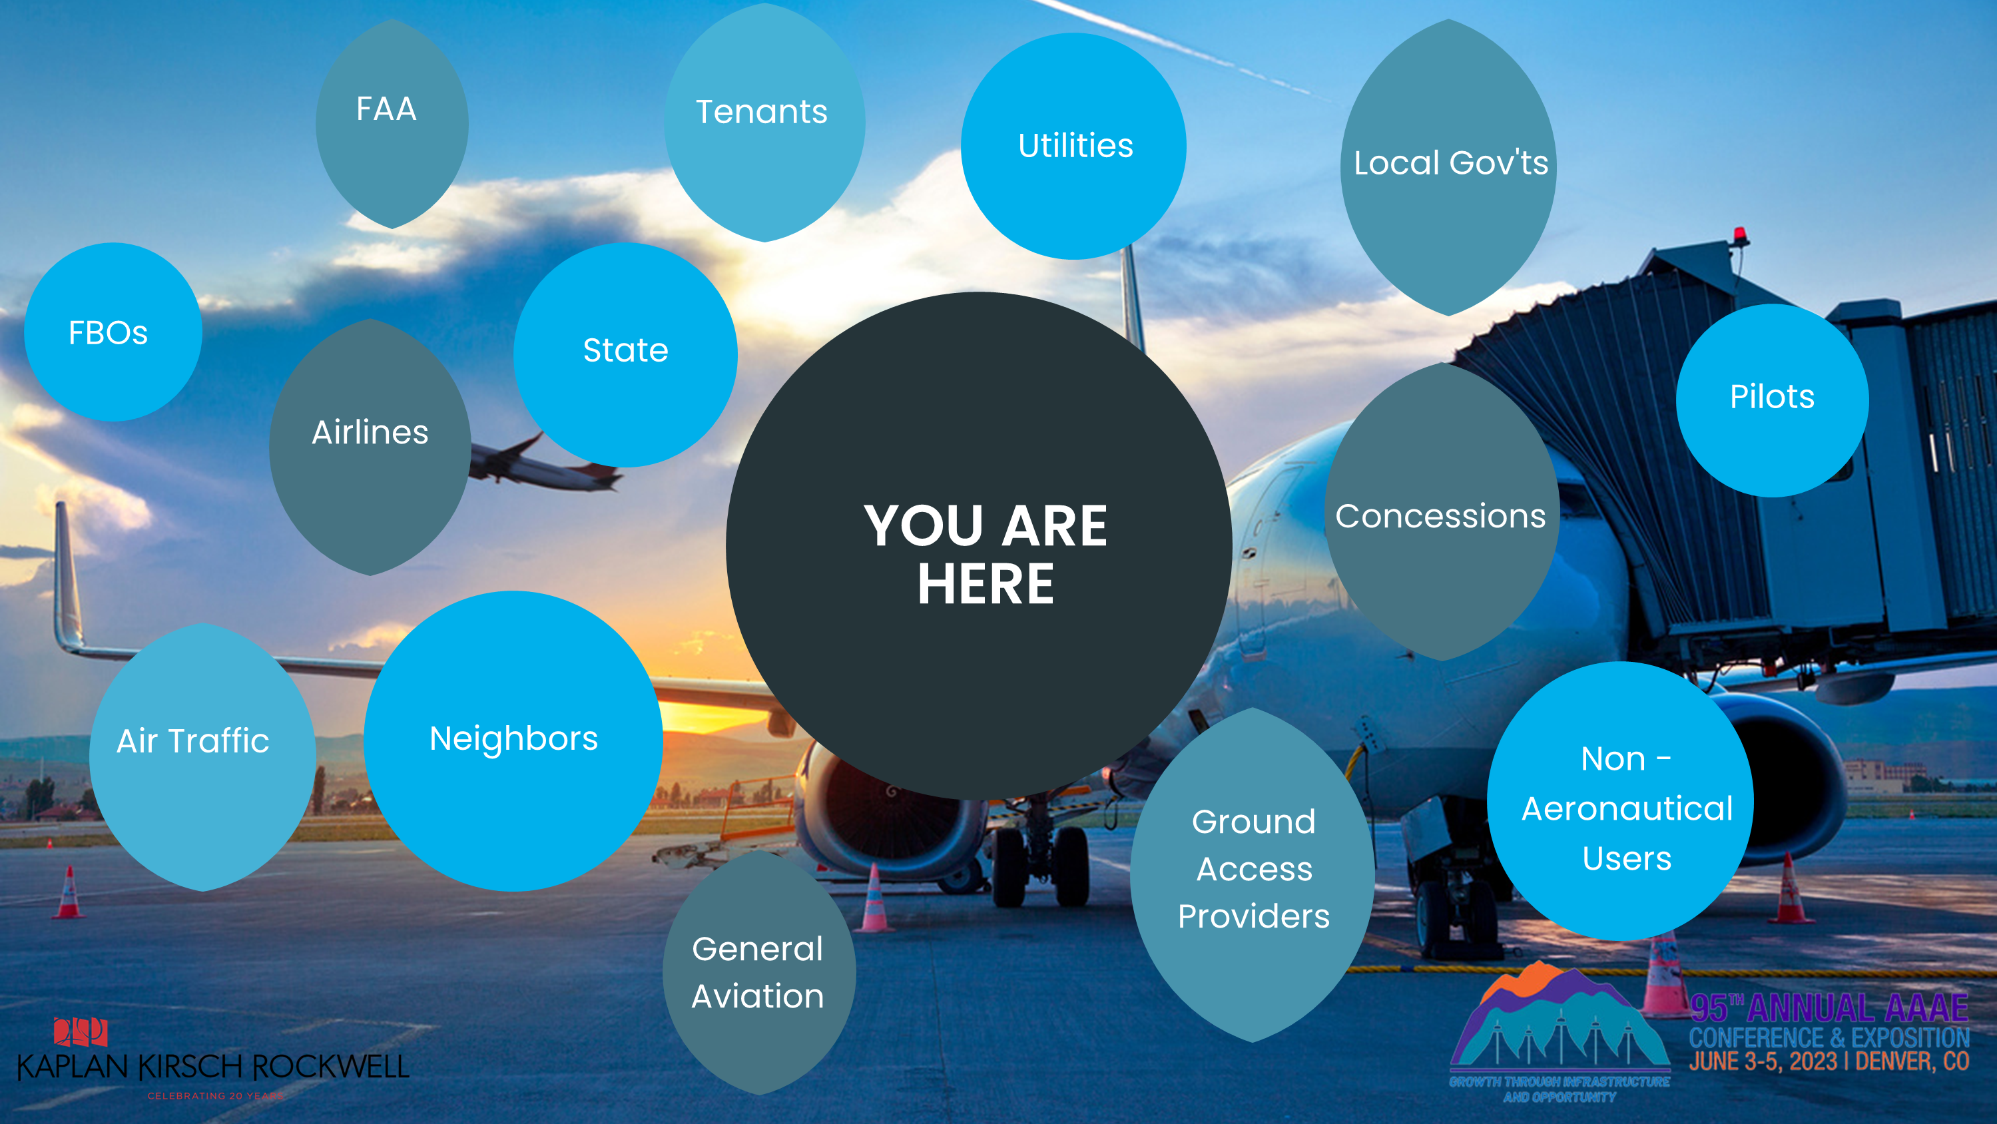

Slide 26

FAA REGULATION LEADS TO PREEMPTION

Slide 27
FEDERAL PREEMPTION I
Types of preemption
  Field (everything)
  Conflict (where in conflict with federal law)
Sources of preemption
  Express (federal statutes)
  Implied (from Congressional intent or case law)
Most – but not all – issues concerning land use and operational restrictions fall within conflict and implied preemption

Slide 28
FEDERAL PREEMPTION II
Operation of national aviation system is a “cooperative scheme”
  FAA (aircraft and airspace)
  Airports (ground operations; airport operations)
  Congress has preserved “proprietary powers and rights” of airport operators (not police powers)
Jurisprudence has evolved in the last 100 years
  Few bright lines

Slide 29
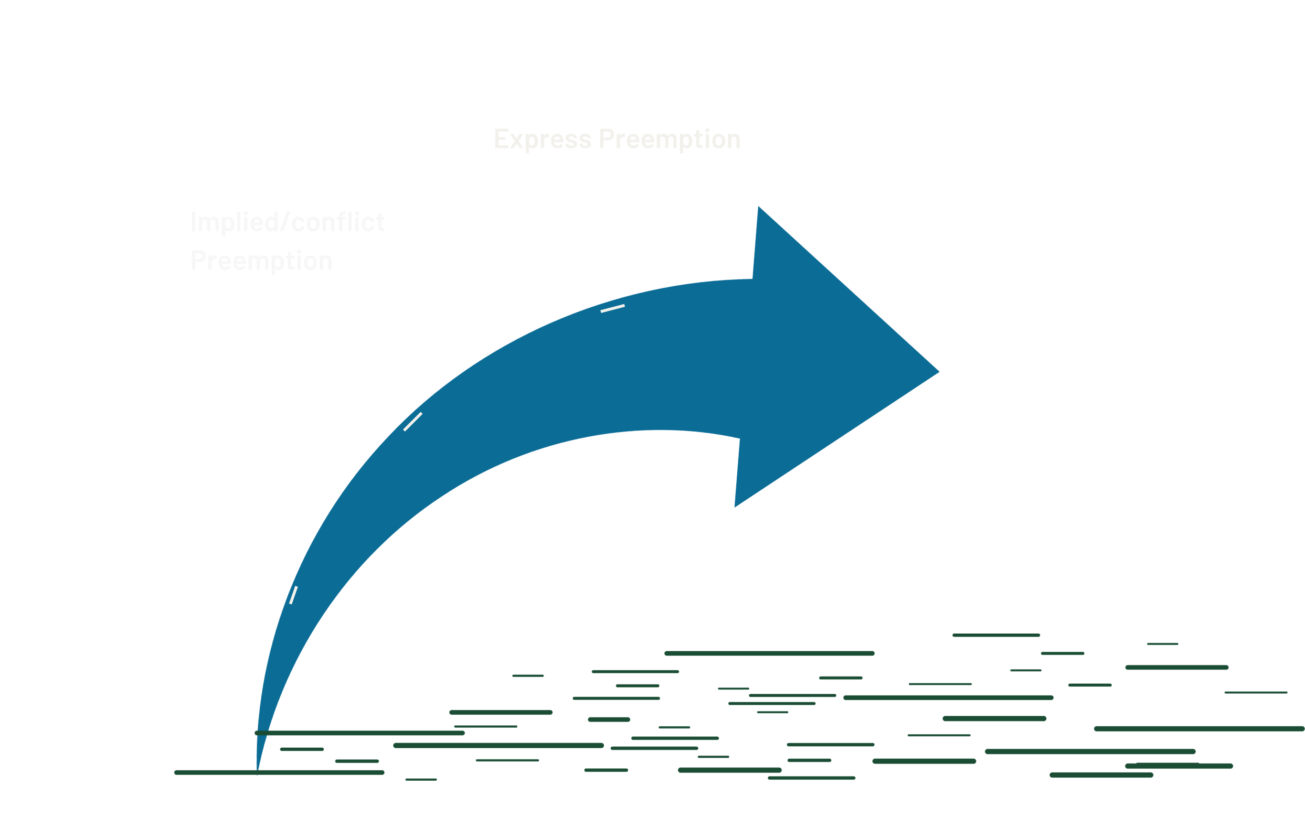

Slide 30
QUESTIONS TO ASK ABOUT STAKEHOLDERS
What is my legal relationship?
What is the stakeholder’s role?
Is the relationship governed or influenced by…
  Federal law?
  State or local law?

Slide 31


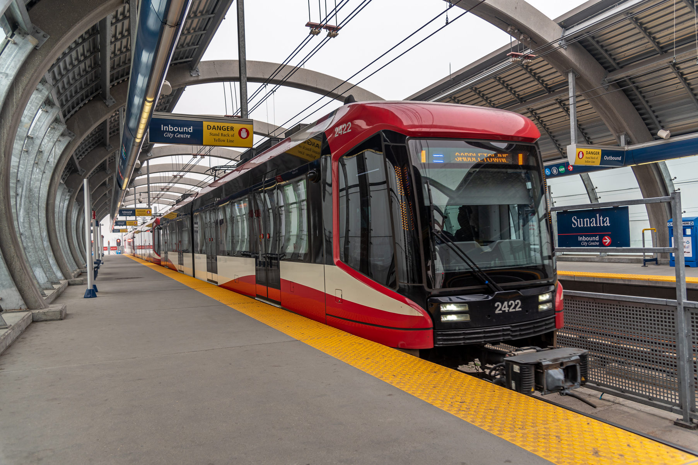
ACCESS PROVIDERS
  State and local DOTs
  Metropolitan Planning Organizations
  FHWA / FTA
  Uber/Lyft
  Ground access providers
  Local transit

Slide 32
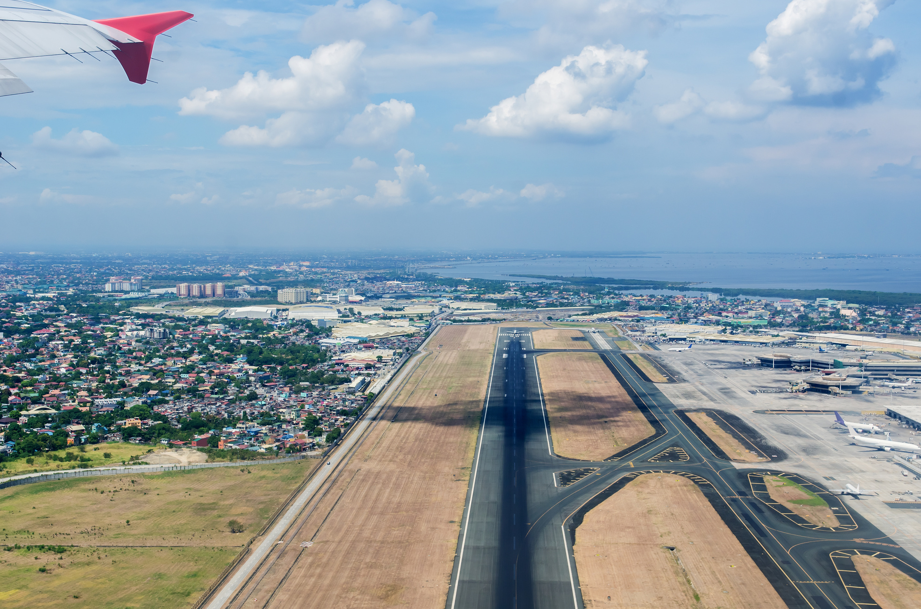
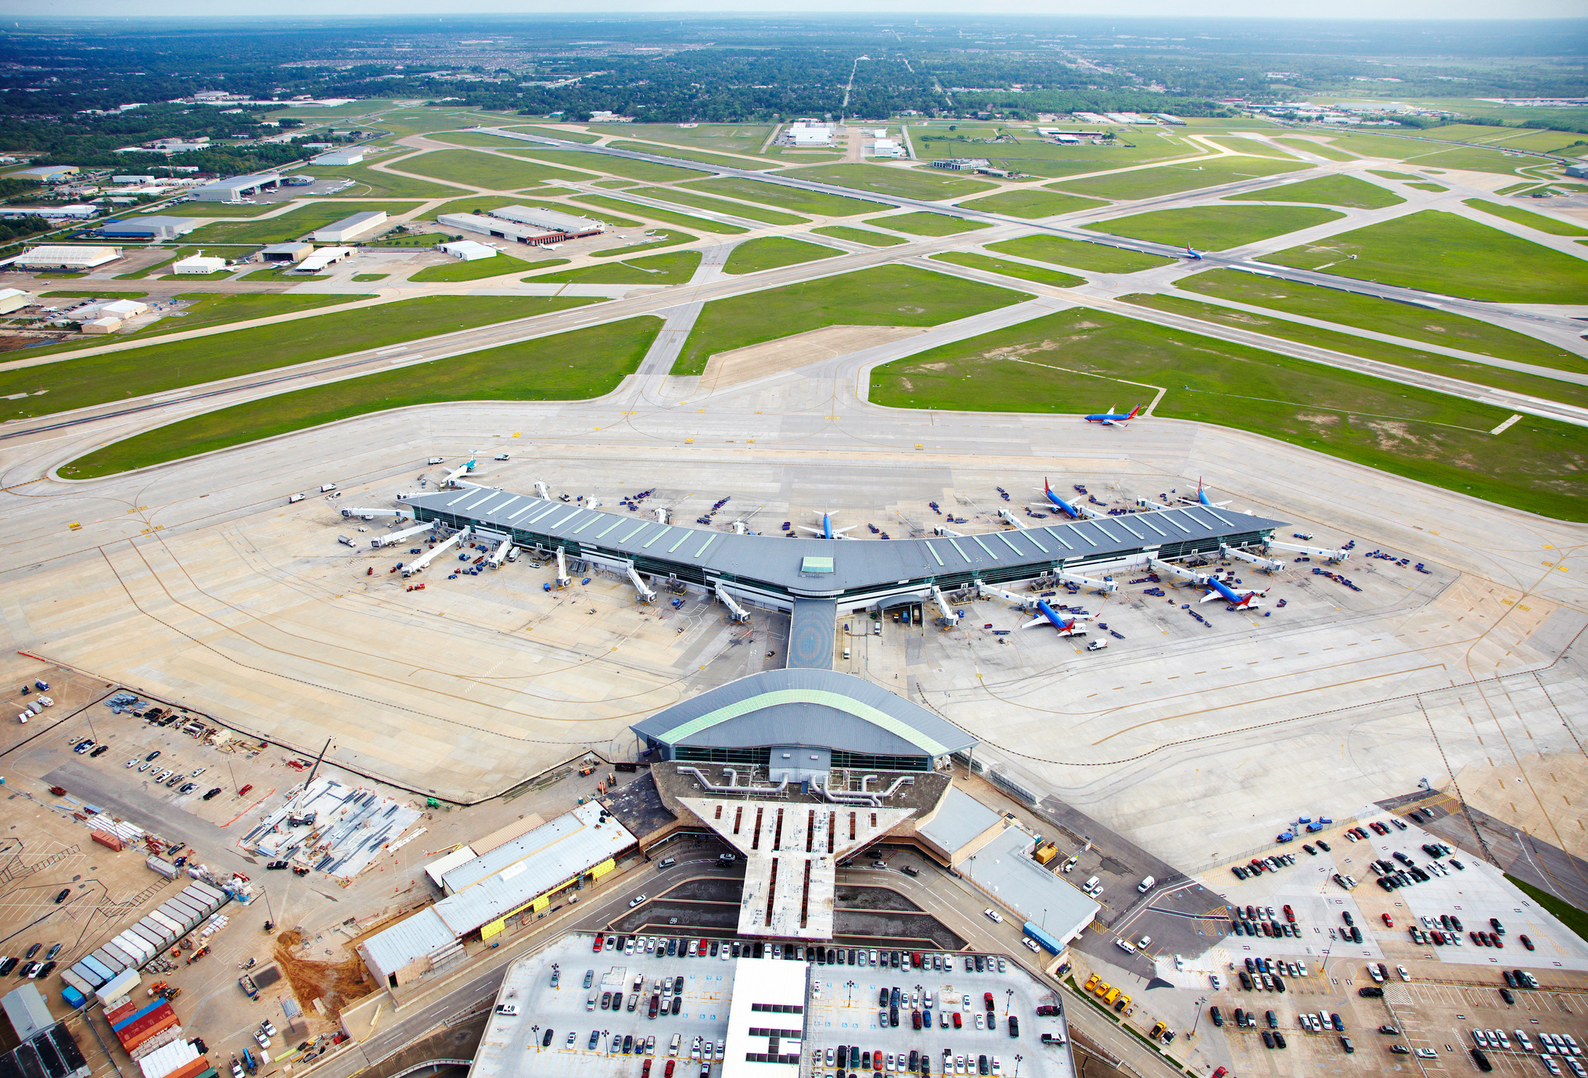
NEIGHBORS
Encroachment and land uses affecting airports
  Grant Assurances 20 & 21
  State land use / aeronautics laws
  Local zoning
  IGAs
  Part 77

Slide 33

CONCESSIONARIES
Concessionaires
  A special kind of tenant
  Subject to federal DBE provisions
  Contentious because of the stakes
Vendors/Suppliers

Slide 34

OTHER TENANTS
Aeronautical
  Grant Assurance 22
  Minimum Standards
Non - Aeronautical
  Grant Assurance 24
  Releases from Grant Assurances

Slide 35



INVESTORS
PRIVATE EQUITY INVESTORS
PRIVATE DEBT INVESTORS
RATING AGENCIES

Slide 36

AIRPORT LAW MUST ADAPT QUICKLY TO
SOCIAL AND ECONOMIC CHANGES

Slide 37
SEVEN KEY THEMES

Slide 38
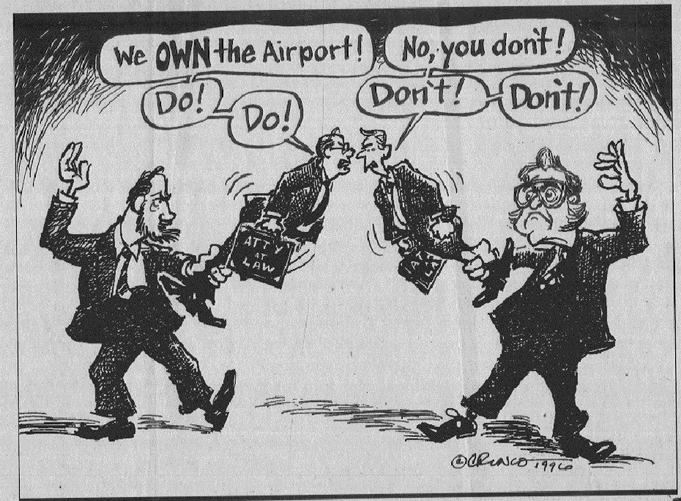
1. IT MATTERS WHO OWNS, OPERATES THE AIRPORT

Slide 39

2. KNOW THE SOURCE OF LEGAL AUTHORITY
Federal
Local/ Regulatory
Proprietary

Slide 40

3. FEDERAL PREEMPTION IS PERVASIVE

Slide 41


4.TRACK YOUR SOURCES AND USES FUNDS

Slide 42


5. WHICH FAA IS IT?
Airports
Air Traffic
Safety
Space
Notes:
Silos pictures – labels ETO, (ask Peter)

Slide 43

6. UNDERSTAND THE GRANT ASSURANCES

Slide 44

7. COMMON MISTAKES
  Airports have an unlimited supply of money.
  Airports are just like other local government functions.
  The federal government only regulates money and aircraft.
  We can do whatever we want with our airport.
  Airports only exist to serve _______.

Slide 45

INFORMATION RESOURCES
  Airport Law Desk Reference (annual)
  Airport Law Digests (semi annual)
  FAA website (www.faa.gov)
  www.airportattorneys.com
  AAAE Basics of Airport Law Workshop
  October 15-17, Washington, DC

Slide 46




QUESTIONS?
THANK YOU
Peter J. Kirsch
pkirsch@kaplankirsch.com
(202) 596-1112

